Slide 1


FAST-RIR: FAST NEURAL DIFFUSE ROOM IMPULSE RESPONSE GENERATOR Anton Ratnarajah, Shi-Xiong Zhang, Meng Yu, Zhenyu Tang, Dinesh Manocha, Dong Yu
Presenter : Anton Jeran Ratnarajah (University of Maryland, College Park)

Slide 2
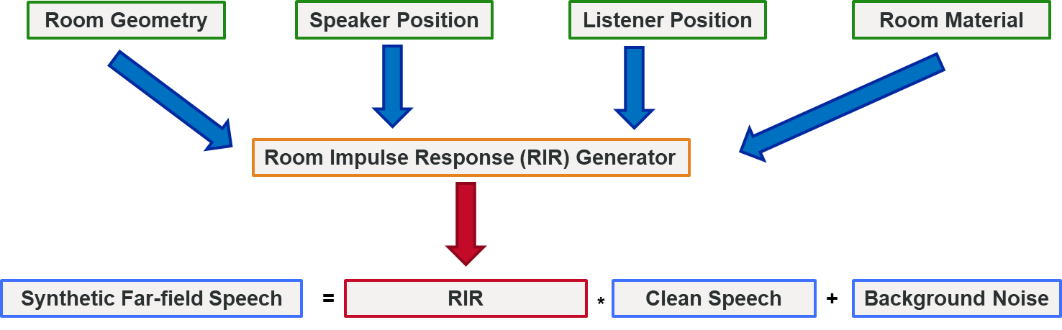
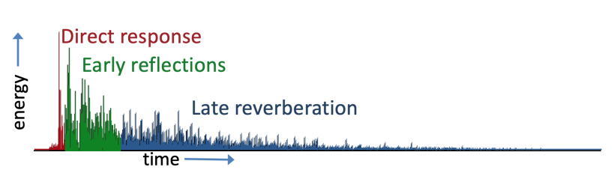
Introduction

Slide 3
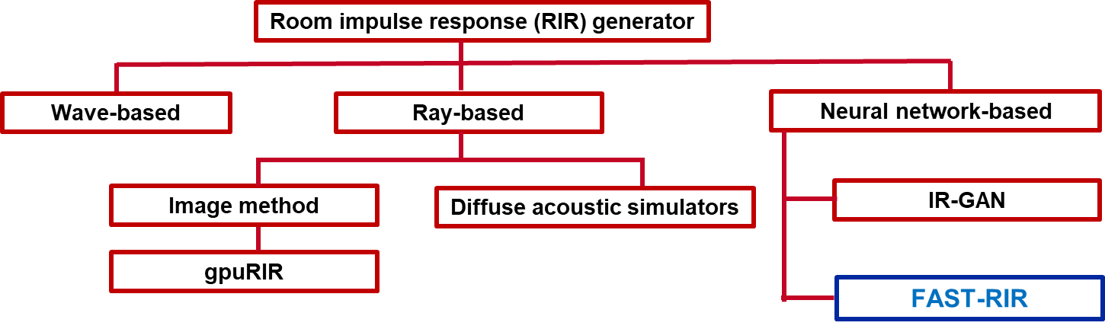
RIR Generator

Slide 4
FAST-RIR
FAST-RIR is a one-dimensional conditional generator network that is trained to generate both specular and diffuse reflection for a given acoustic environment.
We control FAST-RIR using following acoustic environment details.
Shoe-box shaped room dimension
Listener position
Speaker position
Reverberation Time (T₆₀)
Reverberation time is the time taken for the sound energy to decay by 60 decibels. Reverberation time implicitly reflects the characteristics of room materials such as the floor, ceiling, walls, furniture etc.

Slide 5
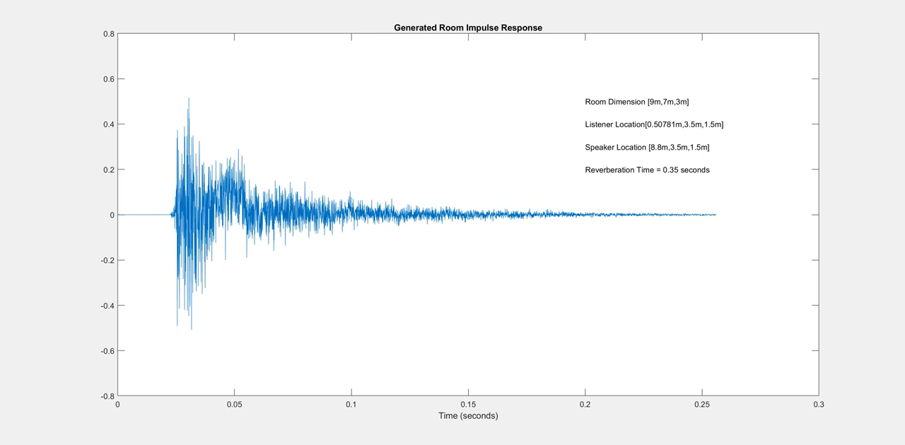
FAST-RIR – Moving the listener in direction x

Slide 6
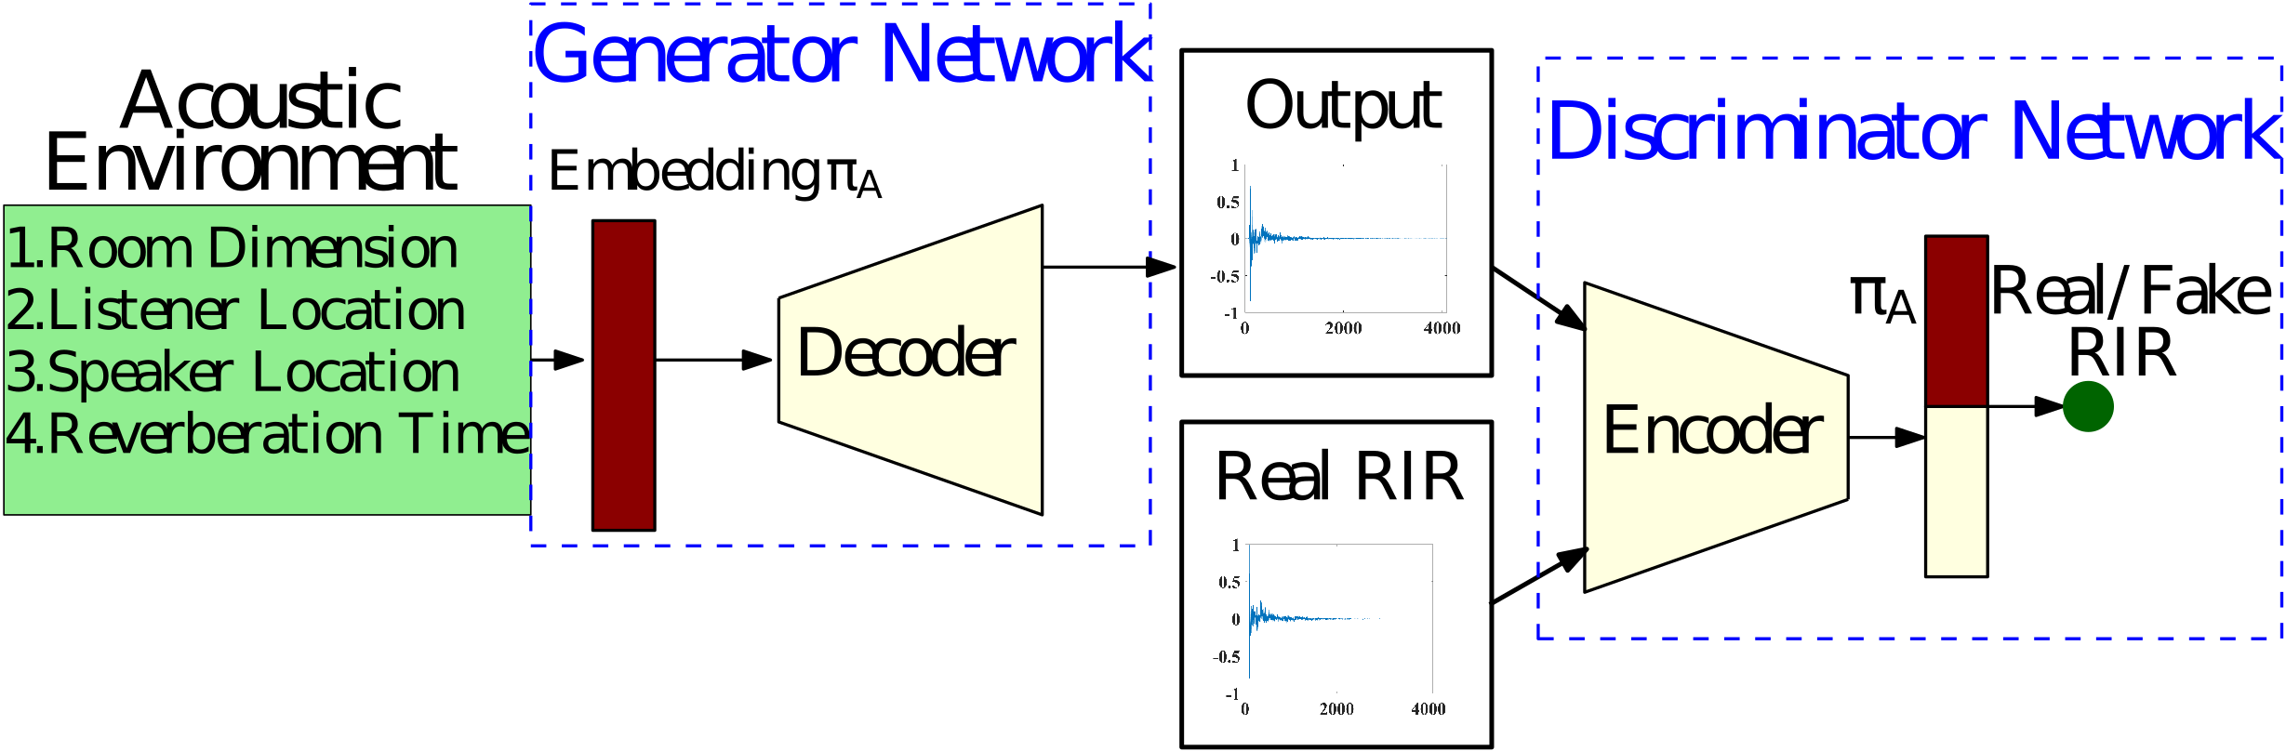
OUR APPROACH -FAST-RIR

Slide 7

OUR APPROACH – Vector Embedding
We combine shoe-box shaped room dimension, listener location, and source location represented using 3D Cartesian coordinates (x,y,z) and reverberation time (T₆₀) as a 10-dimensional vector embedding $π$_{A}
We normalize the vector embedding within the range -1.2 to 1.2 using the largest room dimension in the training dataset.
$π$_{A} = [ Room Dimension, Listener Location, Source Location, T₆₀ ]

Slide 8

OUR APPROACH – Training Dataset
For each $π$_{A}, we generate RIRs using a diffuse acoustic simulator (R_{D}) and use it as ground truth to train our network.
We train our network using 75,000 RIRs generated for medium sized rooms with room dimensions varying in following range.
Room Length : 8m to 11m
Room Width : 6m to 8m
Room Height : 2.5m to 3.5m

Slide 9




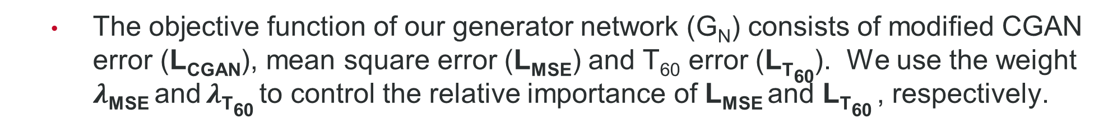
OUR APPROACH – Objective Function
The objective function of our generator network (G_{N}) consists of modified CGAN error (L_{CGAN}), mean square error (L_{MSE}) and T₆₀ error (L_{T60}). We use the weight $λ$_{MSE} and $λ$_{T60} to control the relative importance of L_{MSE} and L_{T60} , respectively.
Modified CGAN error :
Mean square error :
T₆₀ error :

Slide 10
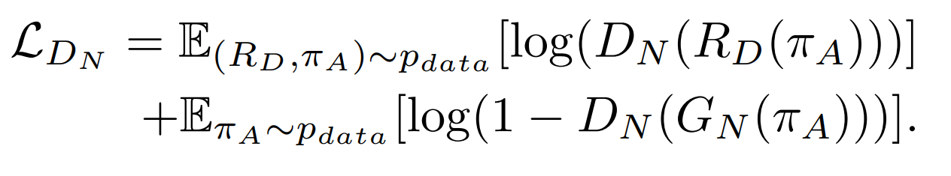
OUR APPROACH – Objective Function
We train our discriminator network (D_{N}) using the modified CGAN error. The discriminator network is trained to discriminate the generated RIRs using our FAST-RIR with the ground truth RIRs for a given acoustic environment.

Slide 11
Experiments - Baseline
We randomly select 30,000 different acoustic environments within the range of the training dataset and generate RIRs corresponding to the selected acoustic environments using the following RIR generators to evaluate the performance of FAST-RIR.
Image method [1]
Diffuse Acoustic Simulator (DAS) [2]
gpuRIR [3]
FAST-RIR
Jont B. Allen and David A. Berkley, “Image method for efficiently simulating small-room acoustics,” Acoustical Society of America Journal, vol. 65, no. 4, pp. 943–950, Apr. 1979.
Zhenyu Tang, Lianwu Chen, Bo Wu, Dong Yu, and Dinesh Manocha, “Improving reverberant speech training using diffuse acoustic simulation,” in ICASSP. 2020, pp. 6969–6973, IEEE.
David Diaz-Guerra, Antonio Miguel, and Jose R Beltran, “gpurir: A python library for room impulse response simulation with gpu acceleration,” Multimedia Tools and Applications, vol. 80, no. 4, pp. 5653–5671, 2021.

Slide 12
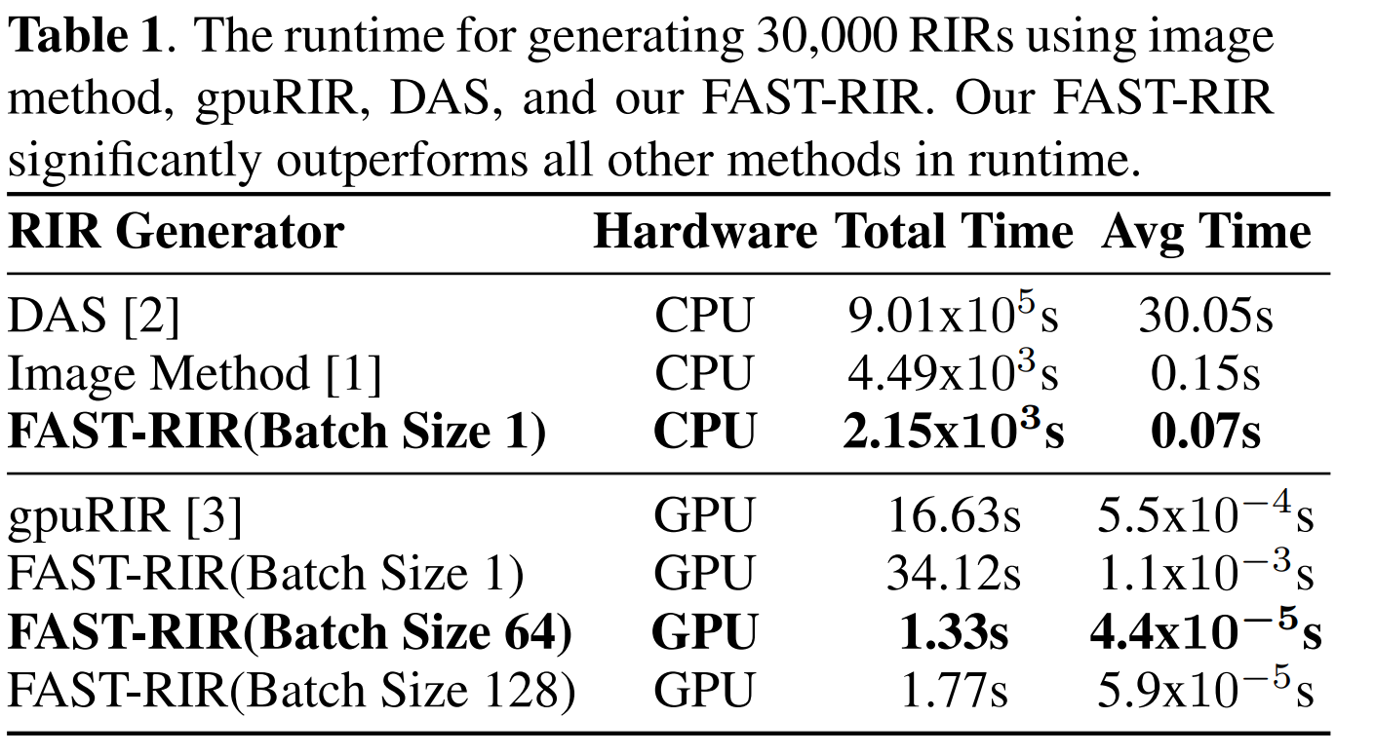
Experiments - Runtime

Slide 13
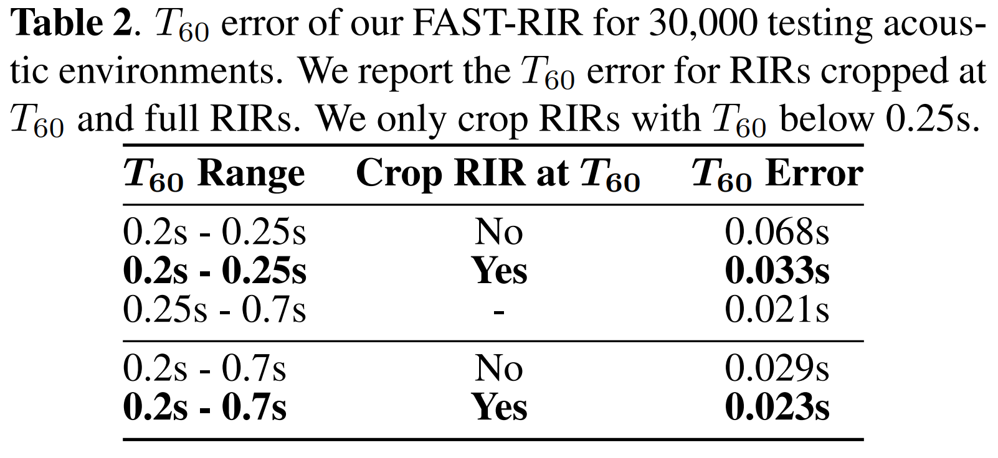
Experiments – T₆₀ Error

Slide 14
Experiments – Automatic Speech Recognition
We use close-talk speech data recorded using Individual Headset Microphones (IHM) and distant speech data recorded using Single Distant Microphones (SDM) from AMI corpus.
We modified the Kaldi recipe to take IHM data as the training set and SDM data as the test set.
We artificially created distant speech training data by convolving IHM data with 30,000 RIRs generated using image method, gpuRIR, DAS, and FAST-RIR.

Slide 15
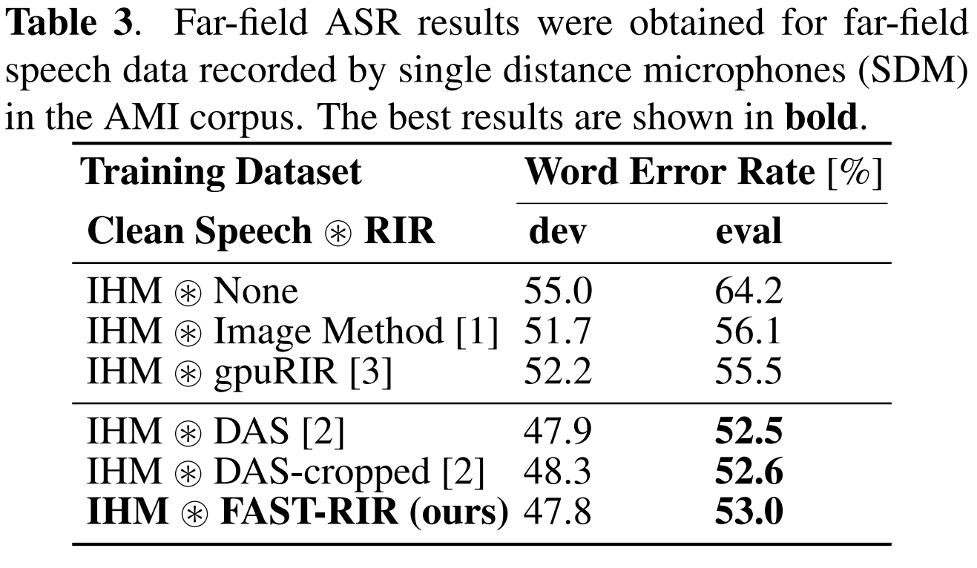
Experiments – Automatic Speech Recognition

Slide 16

Discussion and Future Work
We propose a novel FAST-RIR architecture to generate large RIR dataset on the fly.
Our FAST-RIR performs similarly in ASR experiments when compared to the RIR generator (DAS), which is used to generate a training dataset to train our FAST-RIR.
We can easily train our FAST-RIR with the RIRs generated using any state-of-the-art RIR generator to improve the accuracy of RIR generation.
We would like to expand our FAST-RIR to generate RIRs for any complex 3D scenes.

Slide 17

Results
Room Dimension | Listener Location | Speaker Location | Reverberation Time
[8.4m,6.4m,3.1m] | [6.12m,4.02m,2.76m] | [3.69m.3.85m,2.8m] | 0.20s
Description | Audio
Clean Speech
RIR generated using DAS
RIR generated using our FAST-RIR
Reverberant speech simulated using DAS
Reverberant speech simulated using our FAST-RIR

Slide 18
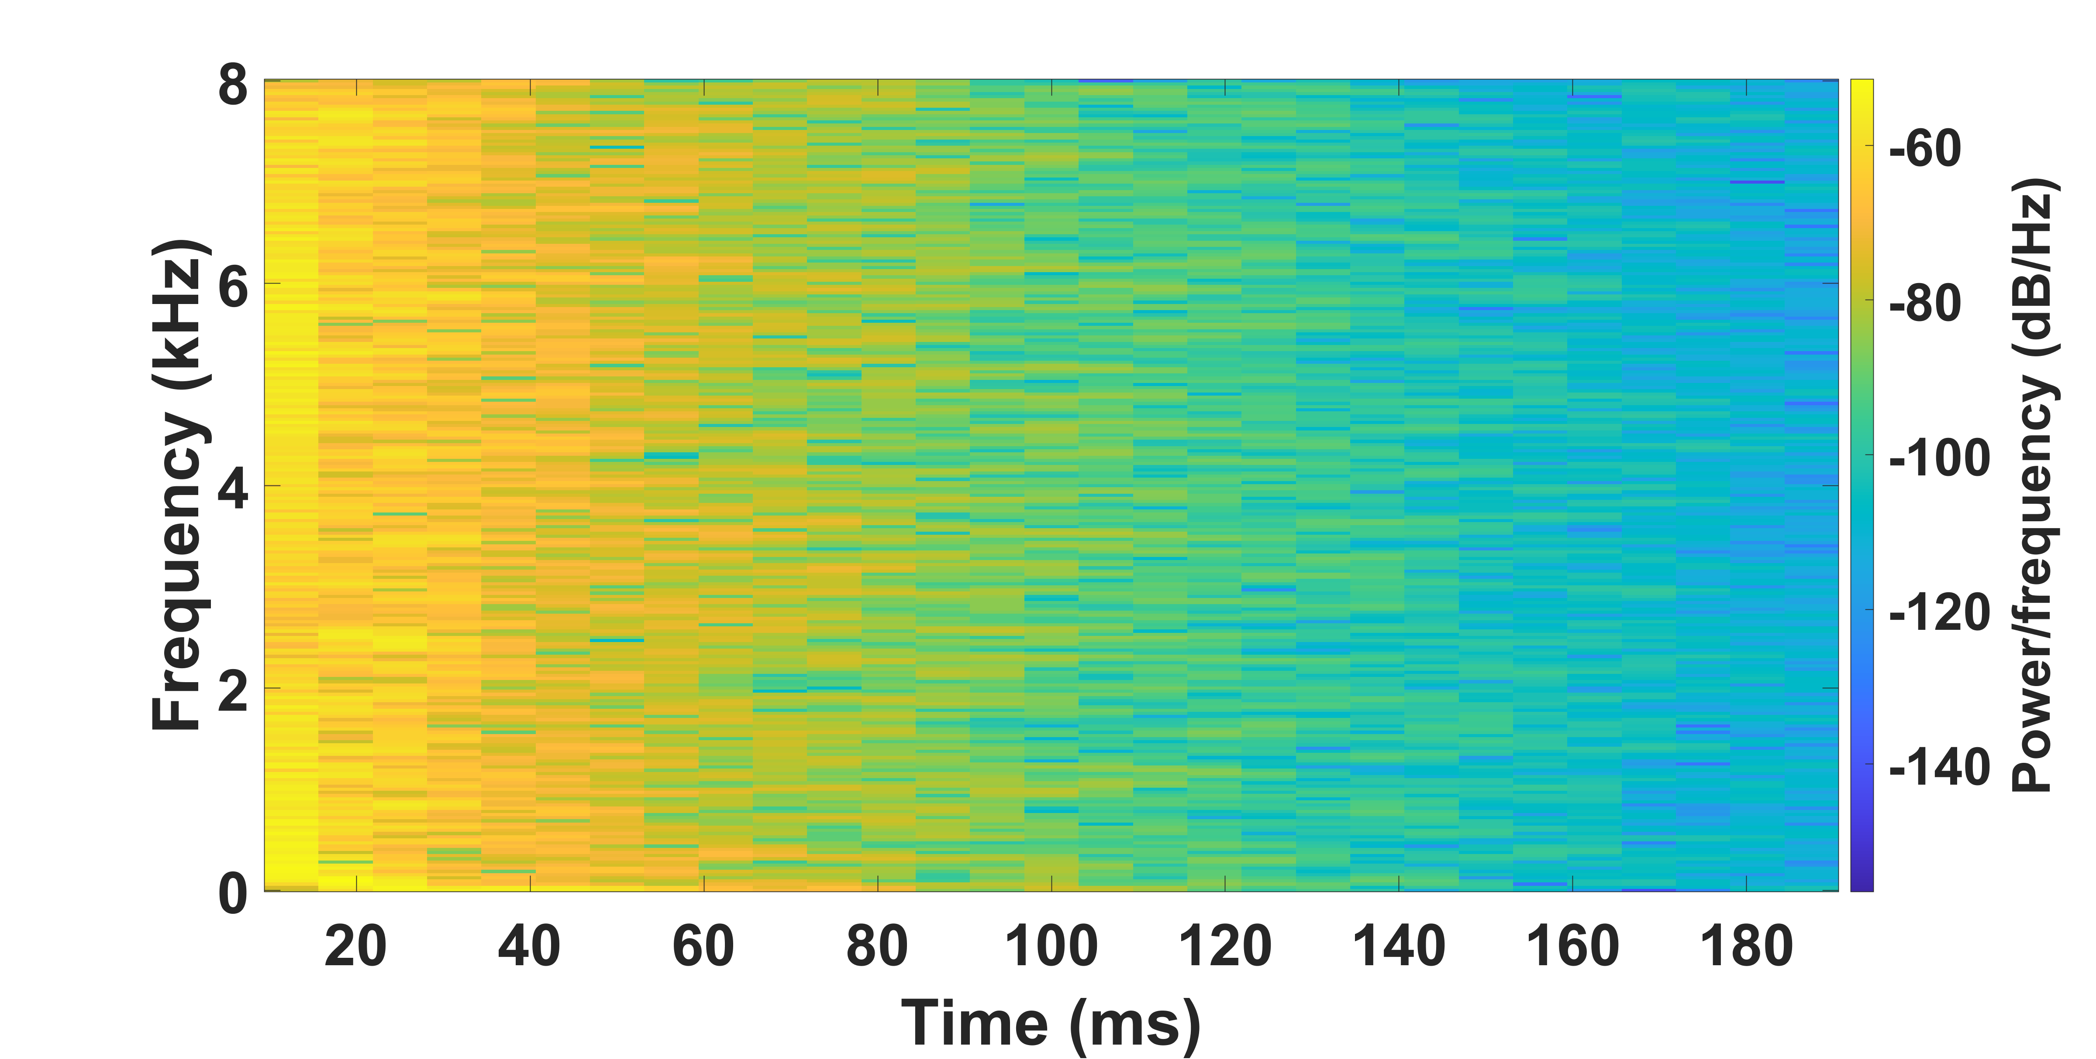
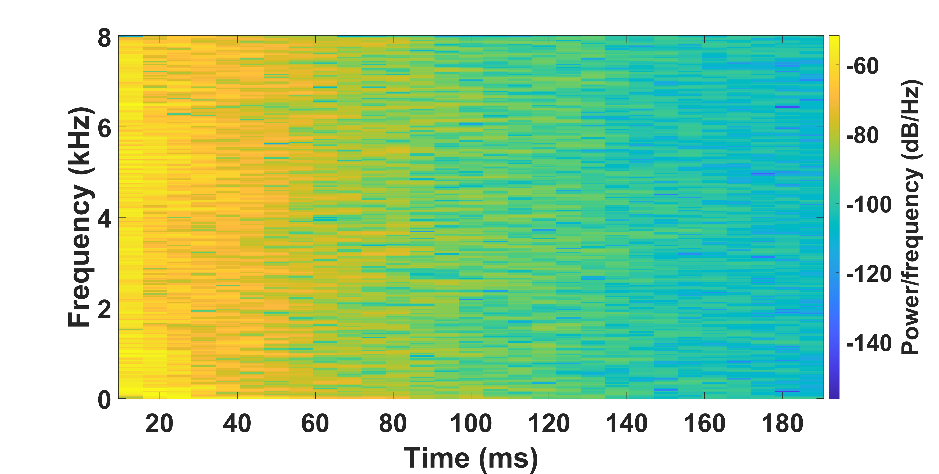
Results
Room Dimension | Listener Location | Speaker Location | Reverberation Time
[8.4m,6.4m,3.1m] | [6.12m,4.02m,2.76m] | [3.69m.3.85m,2.8m] | 0.20s
Spectrogram of RIR generated using DAS
Spectrogram of RIR generated using FAST-RIR

Slide 19
Results
Room Dimension | Listener Location | Speaker Location | Reverberation Time
[9.4m,6.2m,2.7m] | [7.58m,1.94m,0.81m] | [8.02m,1.38m,1.54m] | 0.57s
Description | Audio
Clean Speech
RIR generated using DAS
RIR generated using our FAST-RIR
Reverberant speech simulated using DAS
Reverberant speech simulated using our FAST-RIR

Slide 20
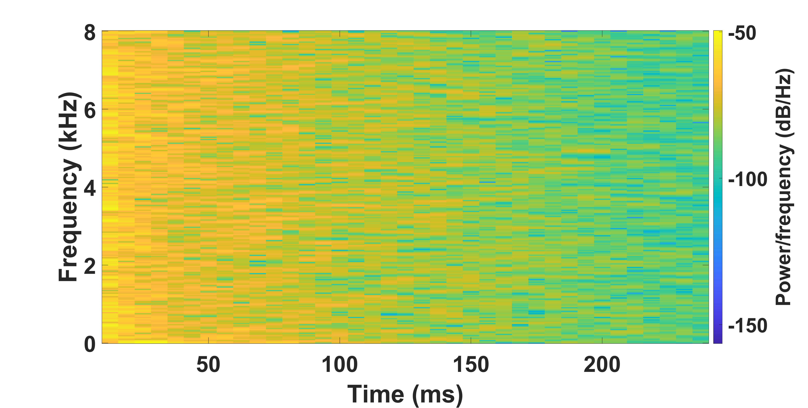
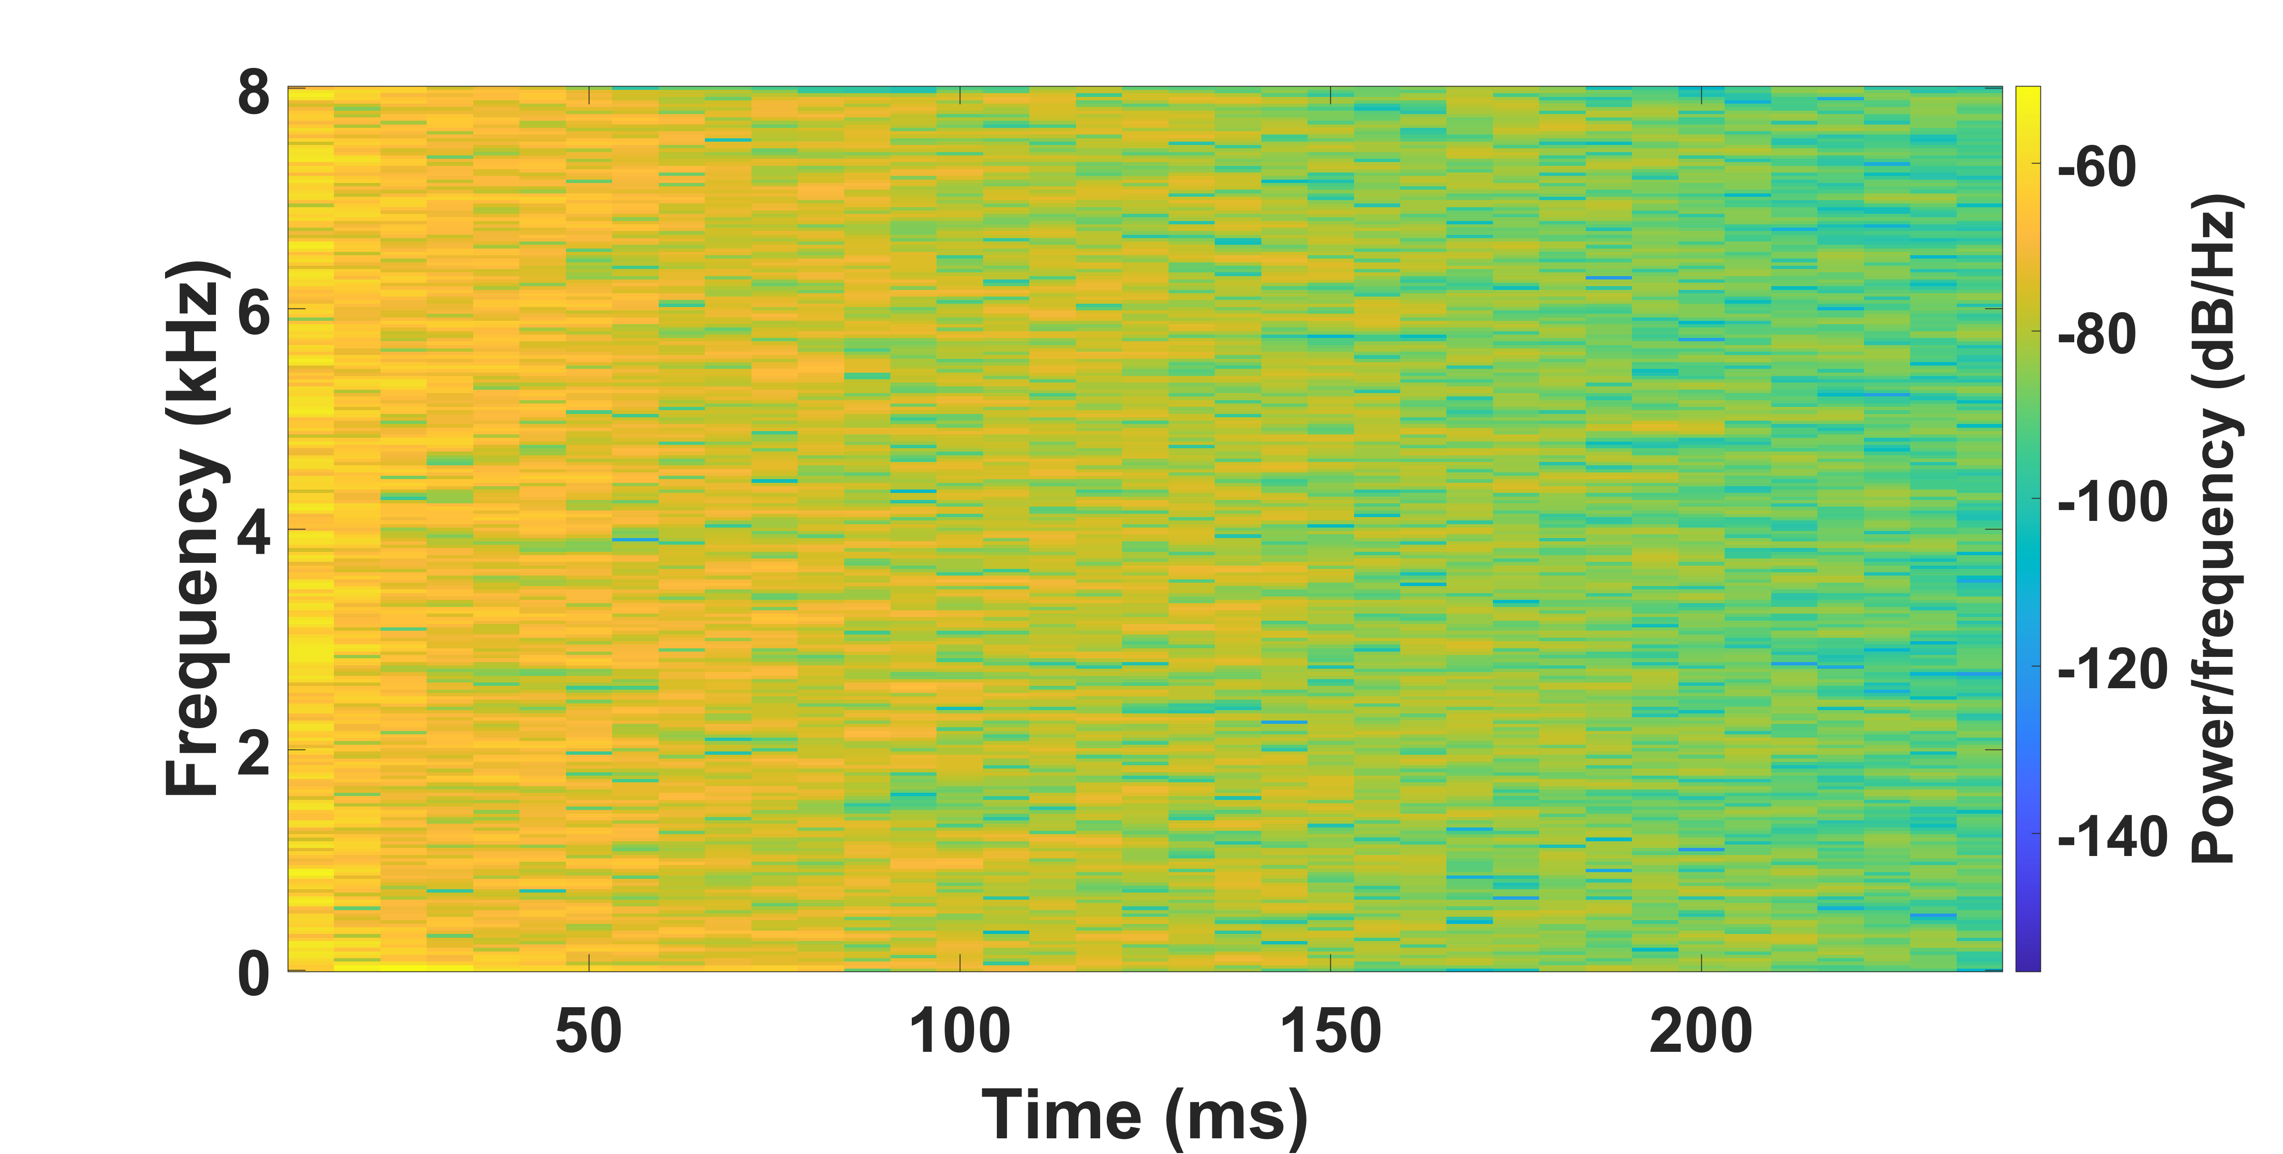
Results
Room Dimension | Listener Location | Speaker Location | Reverberation Time
[9.4m,6.2m,2.7m] | [7.58m,1.94m,0.81m] | [8.02m,1.38m,1.54m] | 0.57s
Spectrogram of RIR generated using DAS
Spectrogram of RIR generated using FAST-RIR

